Slide 1







BUILDING MODULAR APPLICATIONS with .NET and ABP Framework
Download This Presentation
Halil İbrahim KALKAN
Volosoft, Co-founder
@hibrahimkalkan
@hikalkan

Slide 2
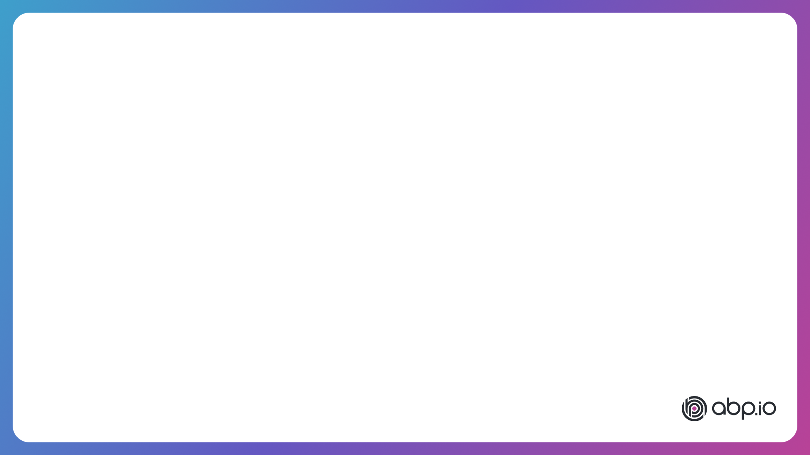

AGENDA
Why modularity?
Architectural options - Database - Codebase
Integration - Designing dependencies - Communication patterns
Live Coding

Slide 3

WHY MODULARITY?
Reducing & managing code complexity
On-premise modular deployment
Migrating to microservices later

Slide 4

DESIGNING
MODULAR
ARCHITECTURE

Slide 5
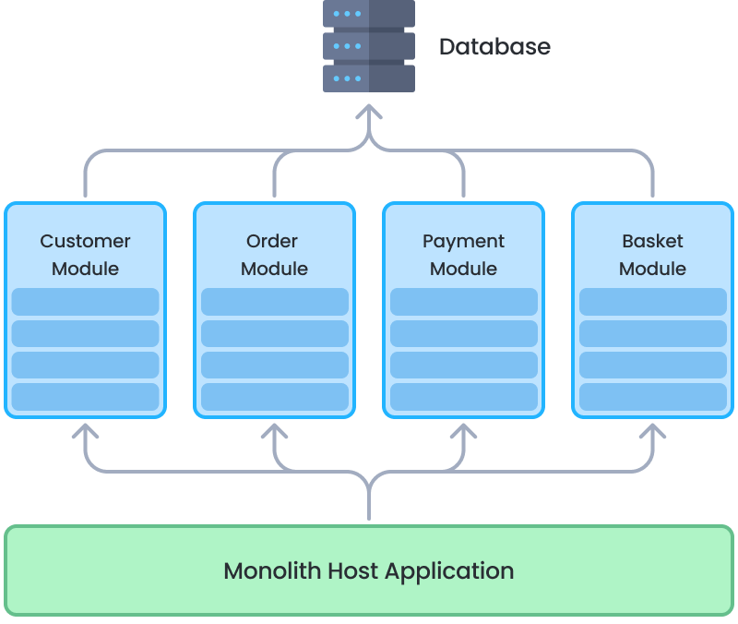
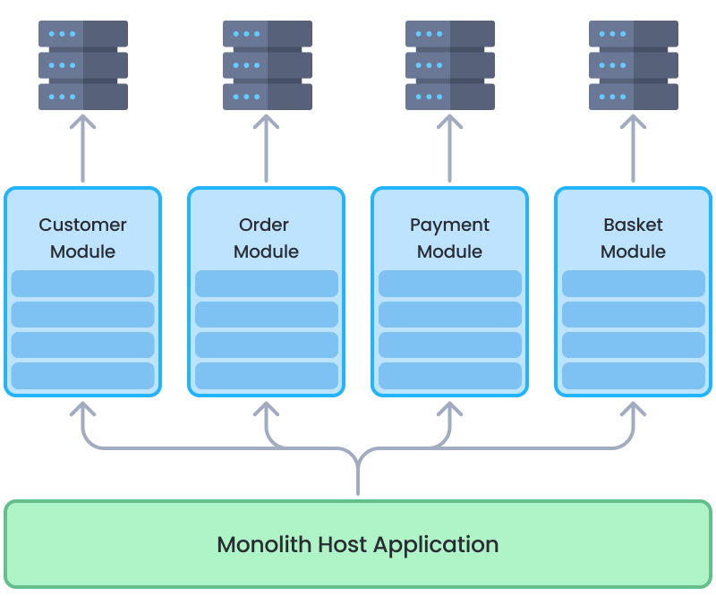
DATABASE ARCHITECTURE OPTIONS
Single (Shared) Database
Separate Module Databases

Slide 6
DATABASE ARCHITECTURE: SINGLE DATABASE
Data access approaches;
Access to only own schema / tables
Manipulate own schema & Read-only access to others

Slide 7
DATABASE ARCHITECTURE: SINGLE DATABASE
Pros:
Possible to make multi-module table JOIN
Possible to ensure database level transactions
Cons:
All modules use the same DBMS technology
Scaling independently for a module is not possible
On Readonly Access: - Easier to break modularity - Schema changes of a module may require change on others

Slide 8
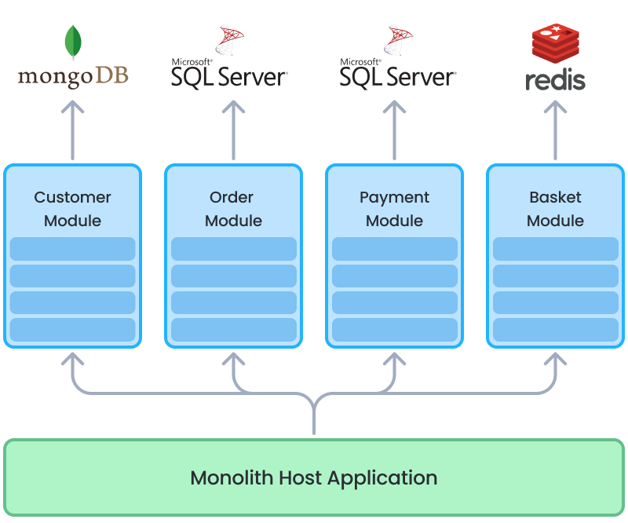
DATABASE ARCHITECTURE: SEPARATE DATABASES
Pros:
Best data isolation
Use Best DBMS technology for each module
Scale databases independently
More microservice ready
Cons:
Hard to prepare multi-module reports
Hard to ensure database level transactions
Hard to set up, maintain and backup
Hybrid: Separate databases only when needed!

Slide 9
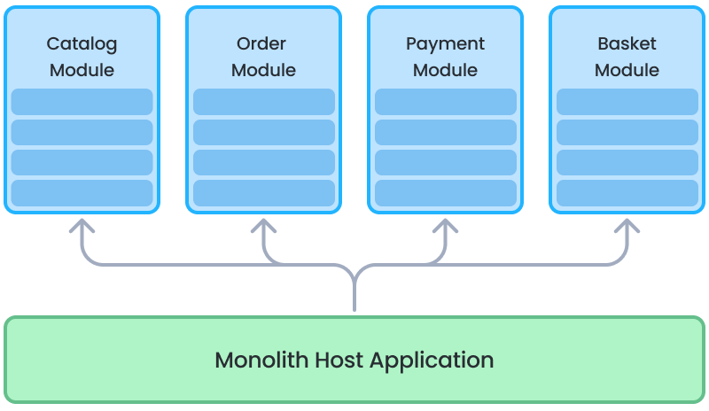
CODEBASE STRUCTURE
Single .NET Solution
Multiple (Separate) .NET Solutions

Slide 10
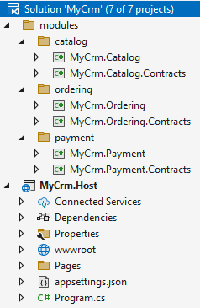
CODEBASE STRUCTURE: SINGLE SOLUTION
Easier and faster to develop and test
Easier to catch breaking changes
Good for small teams
Good if a developer working on multiple modules

Slide 11
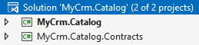
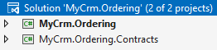
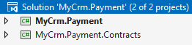
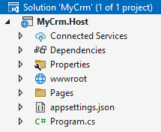
CODEBASE STRUCTURE: MULTIPLE SOLUTIONS

Slide 12
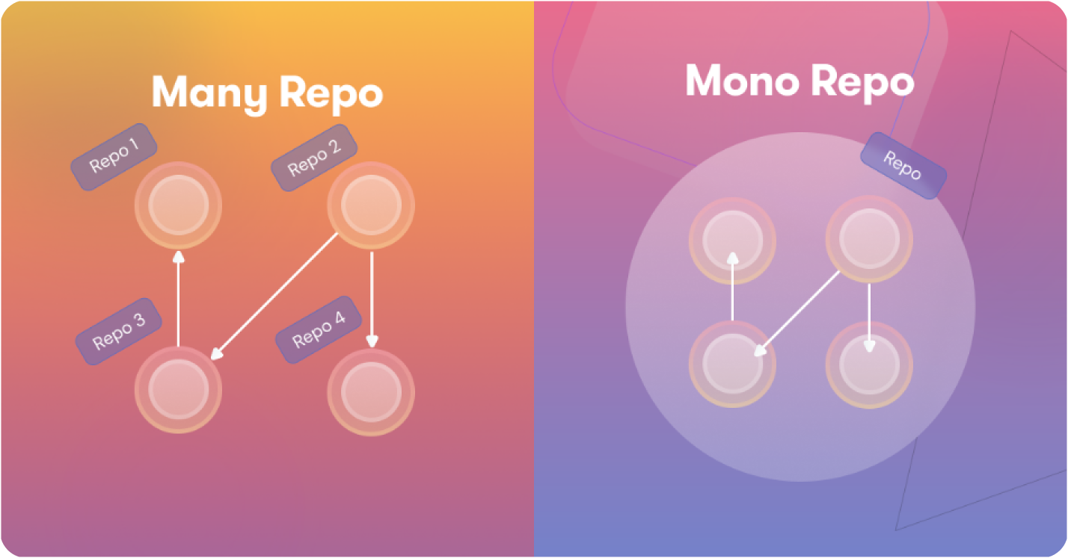
CODEBASE STRUCTURE
?

Slide 13
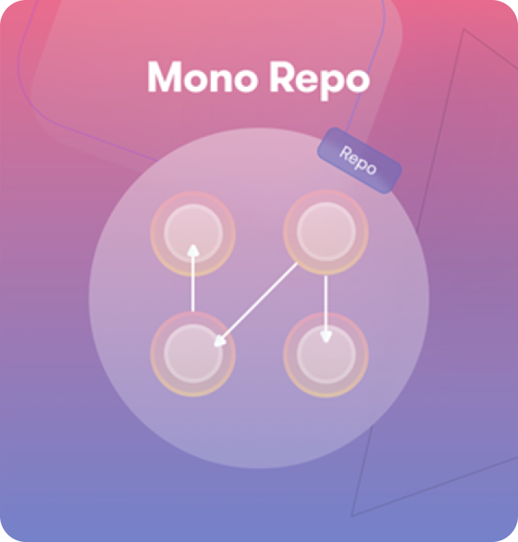
CODEBASE STRUCTURE: MONOREPO APPROACH
All modules are in a single Git repository
Uses local package references (dependencies)
All modules are in same version and deployed together
Pros:
Access to changes immediately by other modules - Good to use new features by other modules - Easier to detect and fix breaking changes
Easier develop, version, test and deploy cycle
Best when:
Small team - A developer work on multiple modules
Modules are small, frequently changing, well integrated
Suggested for majority of projects, especially in the early stages

Slide 14
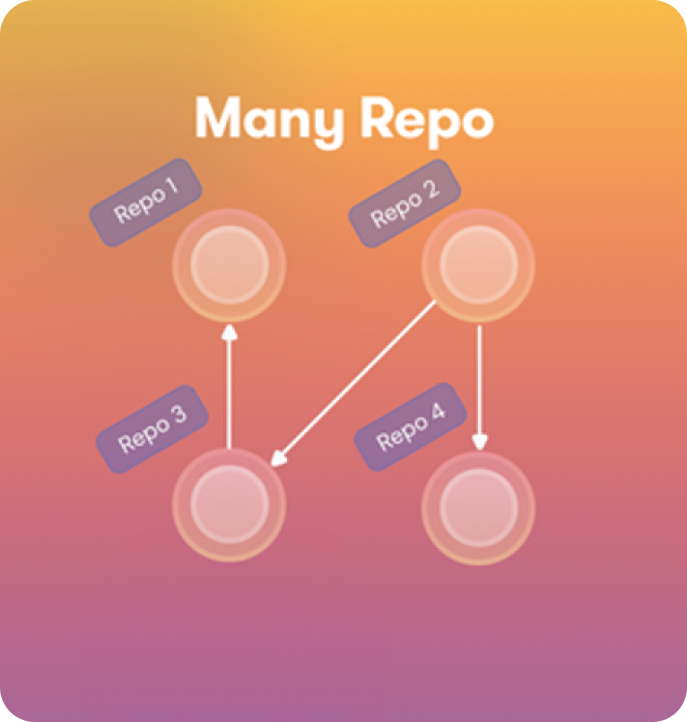
CODEBASE STRUCTURE: MANYREPO APPROACH
Every module located in a separate Git repositories
Uses package (NuGet, NPM, etc) references
Modules are versioned and deployed separately
Pros:
Independent, more focused development for modules
Cons:
Wait changes on depended modules
Deal with breaking changes & backward compability
Complex to develop, test and deploy
Best when:
Many teams (or departments) specialized on different modules
Modules are mature and boundaries are stable or integration is limited
Considering to move to microservices soon

Slide 15
CODEBASE STRUCTURE: SUGGESTIONS
Always begin with - Monorepo - Single solution
Once the module count and team size increases - Monorepo - Multiple solutions
Preparing to a microservice migration - Multiple Repository - Multiple solutions

Slide 16

INTEGRATING THE MODULES

Slide 17
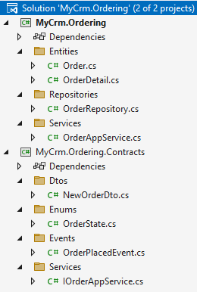
MODULE PACKAGE STRUCTURE
MyCrm.Ordering -> Implementation
Entities, Repositories, Services, etc..
MyCrm.Ordering.Contracts -> Interface
Service interface, DTOs
Event definitions
Enums, constants, etc..

Slide 18
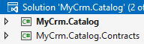
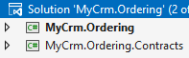
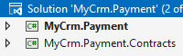
MODULE DEPENDENCIES (ON CONTRACTS)
Ordering Module -> IProductService.CheckStockCount(id)
Ordering Module -> IPaymentService.CreatePaymentRequest(…)
Catalog module -> Subscribe to OrderPlaced & OrderCanceled events

Slide 19
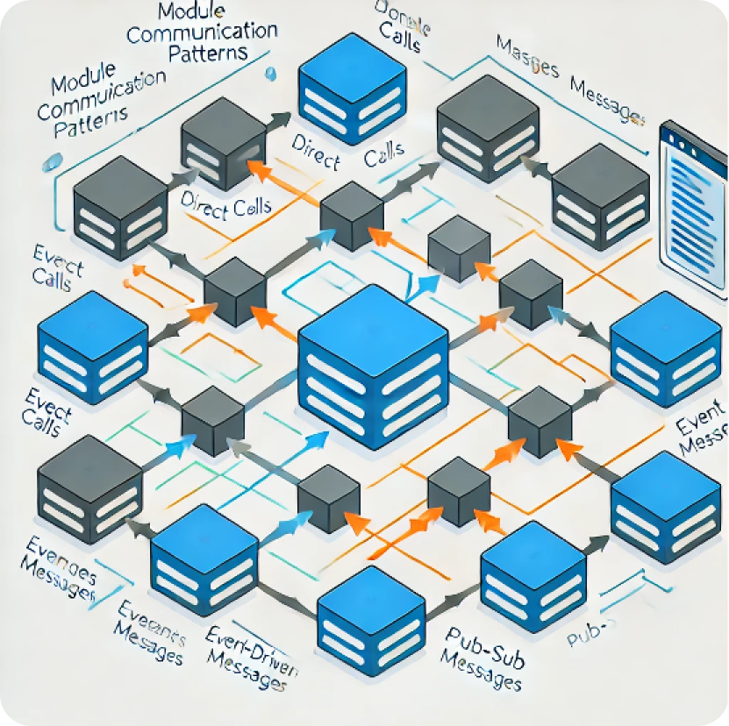
MODULE COMMUNICATION PATTERNS
Integration Services
Integration Events

Slide 20

INTEGRATION SERVICES
Best for read / query operations
Implement caching if possible
Do not reuse application services for integration purposes - Authorization - Caching - Localization - DTO properties - Single responsibility!
UI Application
place
order
monolith host (single process)
Ordering Module
query stock
Catalog Module
ordering database
catalog database

Slide 21
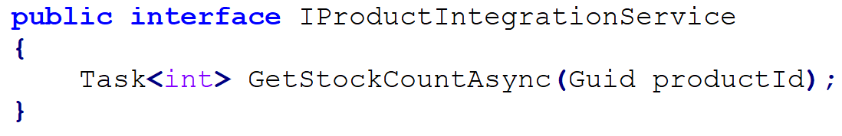
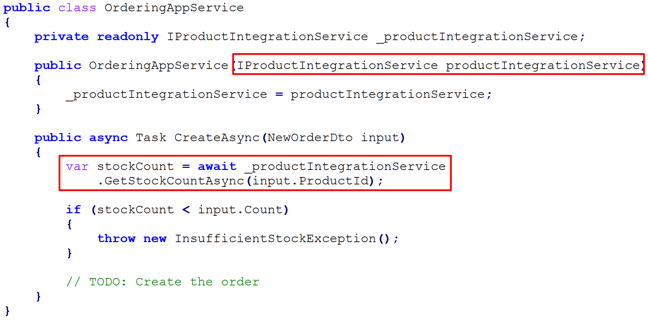
INTEGRATION SERVICES: EXAMPLE
Catalog Module (contract)
Ordering Module

Slide 22
INTGRATION EVENTS
Implement side effects (a change triggers another change in other modules)
UI Application
place
order
monolith host (single process)
event OrderPlaced
Ordering Module
Catalog Module
ordering database
catalog database

Slide 23
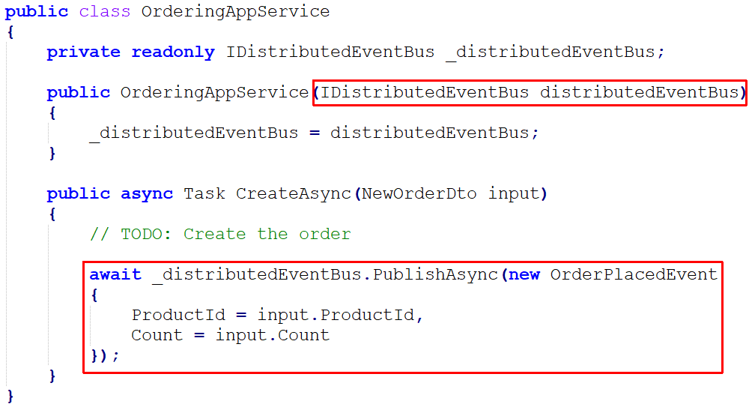
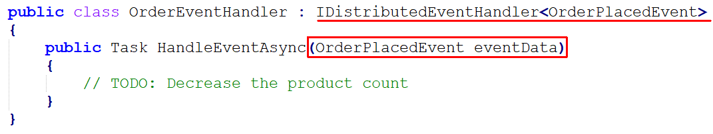
INTEGRATION EVENTS: EXAMPLE
Ordering Module
Catalog Module

Slide 24
LIVE CODING!
DEMO

Slide 25
Download This Presentation
THANKS FOR
LISTENING
Halil İbrahim KALKAN
Volosoft, Co-founder
@hibrahimkalkan
@hikalkan

